Slide 1
Generate Binary Black Hole Initial Data with Physics-Informed DeepONet
Hilary Wu
Imperial College London
Supervisor: Professor Yang Xiang

Slide 2
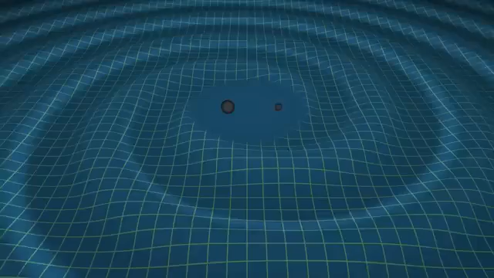
Background
Processing of gravitational wave data
Traditional numerical relativity (NR) techniques vs. ML techniques
Focus on non-spinning binary black hole (BBH) systems
Notes:
Since September 2015, observatories such as LIGO and VIRGO have detected more than 300 probable gravitational wave signals. In order to correctly identify the origins of these signals, an accurate snapshot of the initial gravitational field is needed.
The field that solves the equations that govern the evolution and properties of gravitational waves is called numerical relativity, and traditional NR techniques have proved to be extremely computationally expensive. However, there has been recent work to generate initial data for these systems using machine learning techniques.
My project is an extension to these work, where I trained a neural operator on the equations of numerical relativity. I focused on non-spinning binary blackhole systems, since most gravitational waves detected on Earth originated from BBHs.

Slide 3

Theory
Einstein’s Field Equations:
$$G_{μν}=8πGT_{μν}$$
Hamiltonian Constraint Equation:
$$Δu+\frac{1}{8}{\left(1+\sum_{n}{\frac{m_{n}}{2r_{n}}}+u\right)}^{−7}{\overline{K}}_{ij}{\overline{K}}^{ij}=0$$
Notes:
The equations that describe gravitational fields in general relativity are called Einstein’s Field Equations, which is a set of 10 partial differential equations.
By applying Conformal decomposition on the 6 constraint equations, we obtain the Hamiltonian Constraint Equation, which is a highly elliptical second order PDE.
u is the quantity I am solving for. It is the regular correction to the singular analytic part of the conformal factor, representing the additional nonlinear deformation of the spatial geometry caused by the combined binary configuration, particularly the black holes’ momenta and spins
Einstein tensor
Stress-energy tensor due to matter and radiation
Laplacian
m: mass of the black holes
r: distance from the black holes
K: Trace-free extrinsic curvature, measures how the spatial hypersurface is embedded in spacetime, contains momenta and spins of the system
u: Regular correction to the singular analytic part of the conformal factor, it represents the additional nonlinear deformation of the spatial geometry caused by the combined binary configuration, particularly the black holes’ momenta and spins, and is the quantity I am solving for

Slide 4
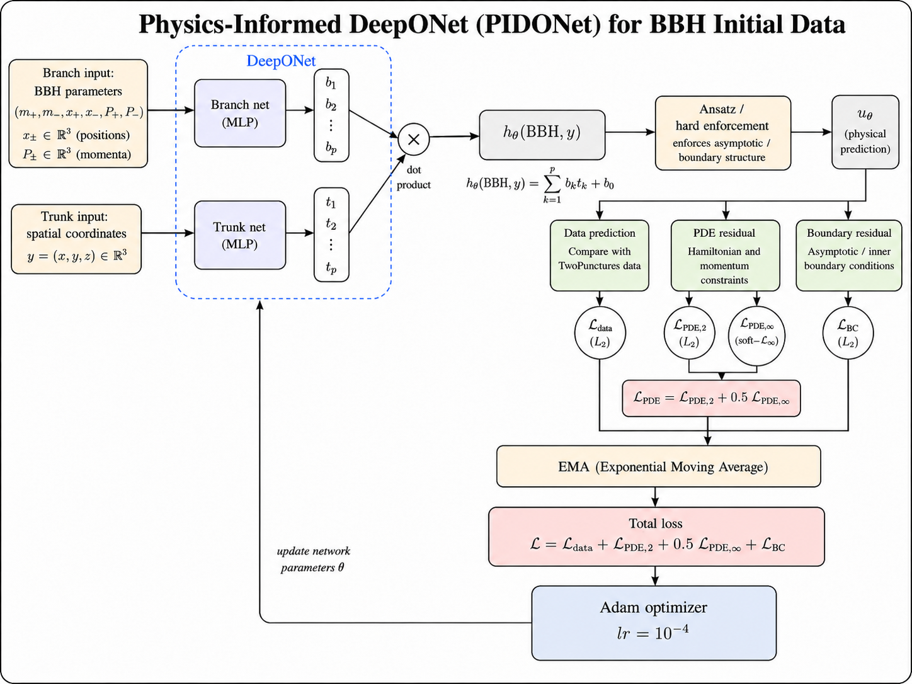
Notes:
This slide shows the flowchart for training the PIDONet, which includes a 14-input branch net for parameters, and a 3-input trunk net for the coordinates in the domain.
Due to the highly elliptical nature of the PDE, the DeepONet predicts an intermediate value h_theta by applying dot product to the outputs of the MLPs and adding an optimisable bias term. The predicted conformal factor correction u_theta can then be obtained by passing h_theta through an ansatz.
In total, 4 loss terms are computed from the prediction term. Since the 4 loss terms have different magnitudes, they are scaled using the EMA method, and are then combined with unitary weight for the 3 L2 losses and half weight for the soft-L_inf loss. Finally, the scaled total loss is passed through an Adam optimizer with a learning rate of 10^-4.

Slide 5
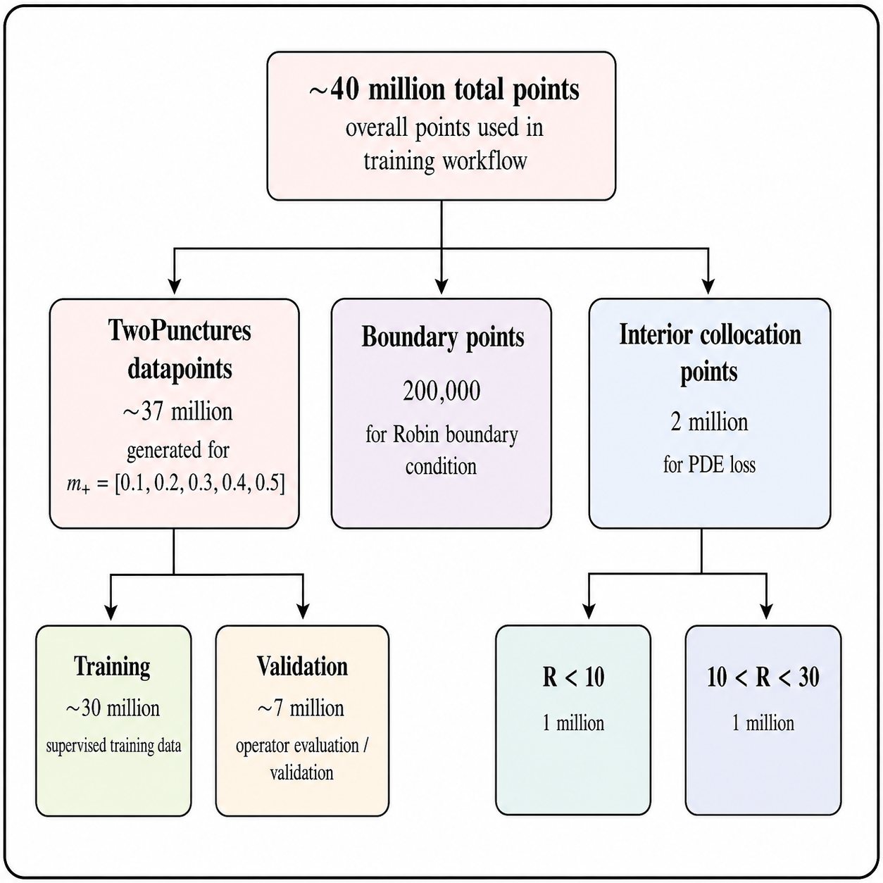
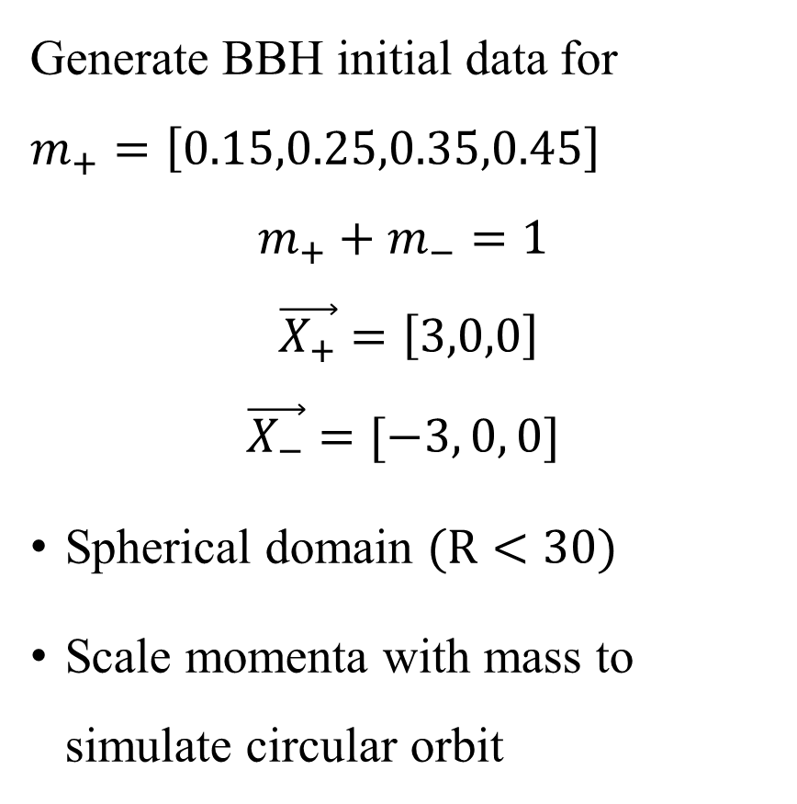
Setup
Generate BBH initial data for $m_{+}=\left[0.15,0.25,0.35,0.45\right]$
$$m_{+}+m_{−}=1$$
$$\vec{X_{+}}=\left[3,0,0\right]$$
$$\vec{X_{−}}=[−3, 0, 0]$$
Spherical domain $(R<30)$
Scale momenta with mass to simulate circular orbit
Notes:
For this project I generated BBH initial data for 4 m-plus values. For symmetric considerations, I imposed a constraint on the mass of the second black hole such that the total mass of the blackholes is 1, and placed the punctures at [+-3, 0, 0].
I limited the domain to a sphere of radius 30, and scaled the momenta with mass to simulate a rough Newtonian circular orbit.
To train the operator, I used a total of 40 million points, which include 30 million training datapoints, 7 million validation datapoints, 2 million interior collocation points, and 200000 boundary points to enforce the Robin boundary conditions.

Slide 6
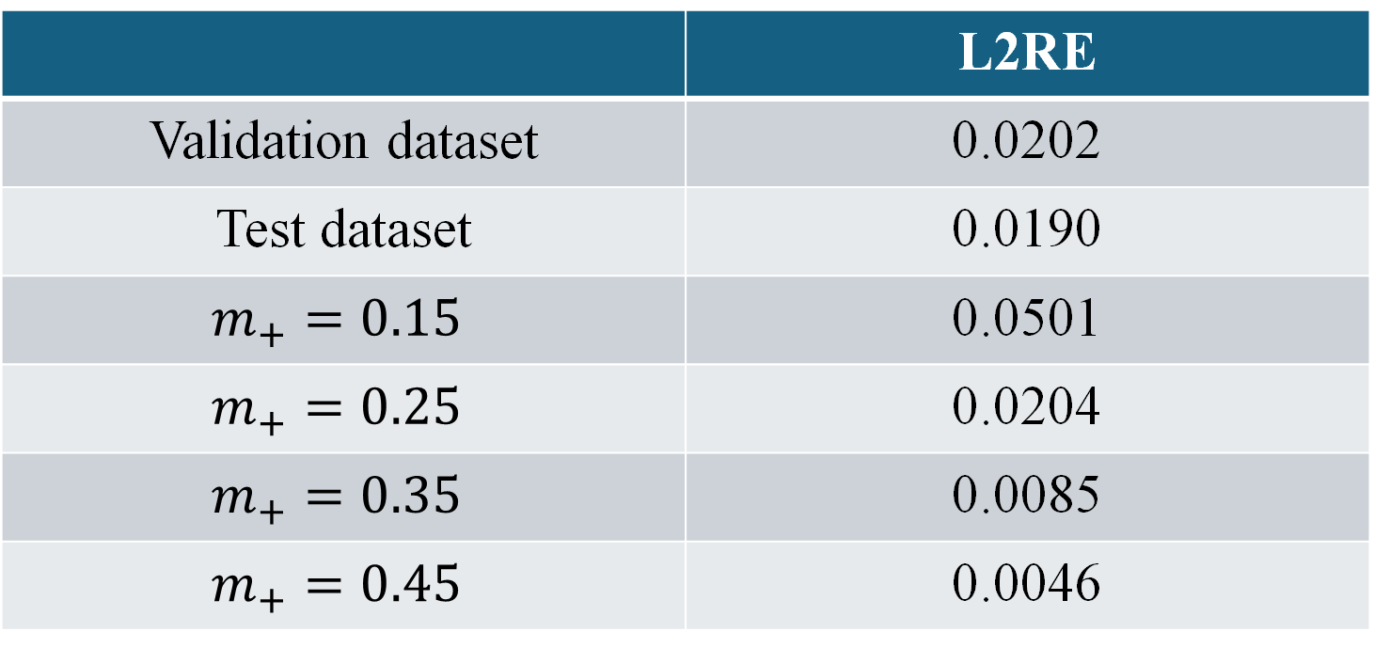
Results
Trained for 2734 epochs (8 hours 20 minutes on A100 GPU)
 | L2RE
Validation dataset | 0.0202
Test dataset | 0.0190
$$m_{+}=0.15$$ | 0.0501
$$m_{+}=0.25$$ | 0.0204
$$m_{+}=0.35$$ | 0.0085
$$m_{+}=0.45$$ | 0.0046
Notes:
Training terminated after 2734 epochs, after the validation loss stopped improving for 150 epochs. The operator took 8 hours and 20 minutes to train on an A100 GPU.
The validation loss stabilised at around 2% while the relative L2 error on the entire test dataset is 0.019. There is a decreasing trend for relative L2 error for higher m-plus values, with a 5% error for m-plus 0.15 and less than 0.5% error for m-plus 0.45.

Slide 7
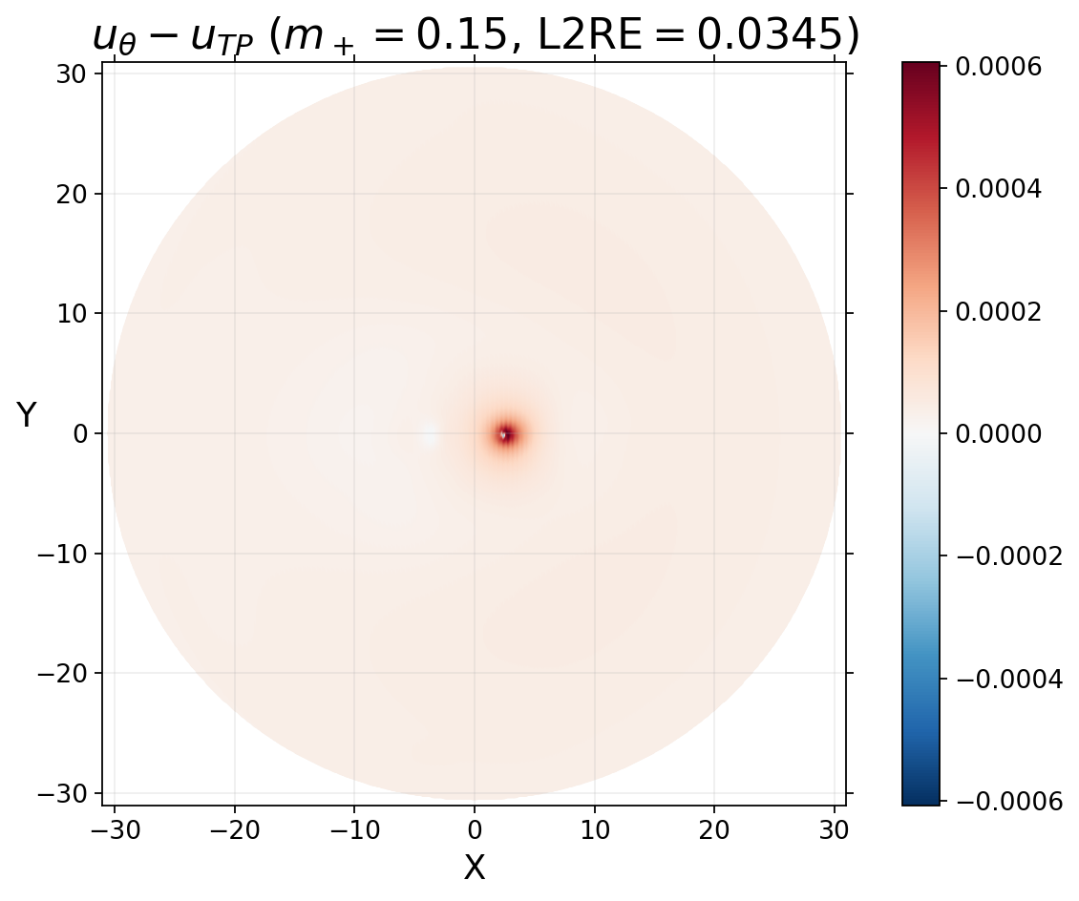
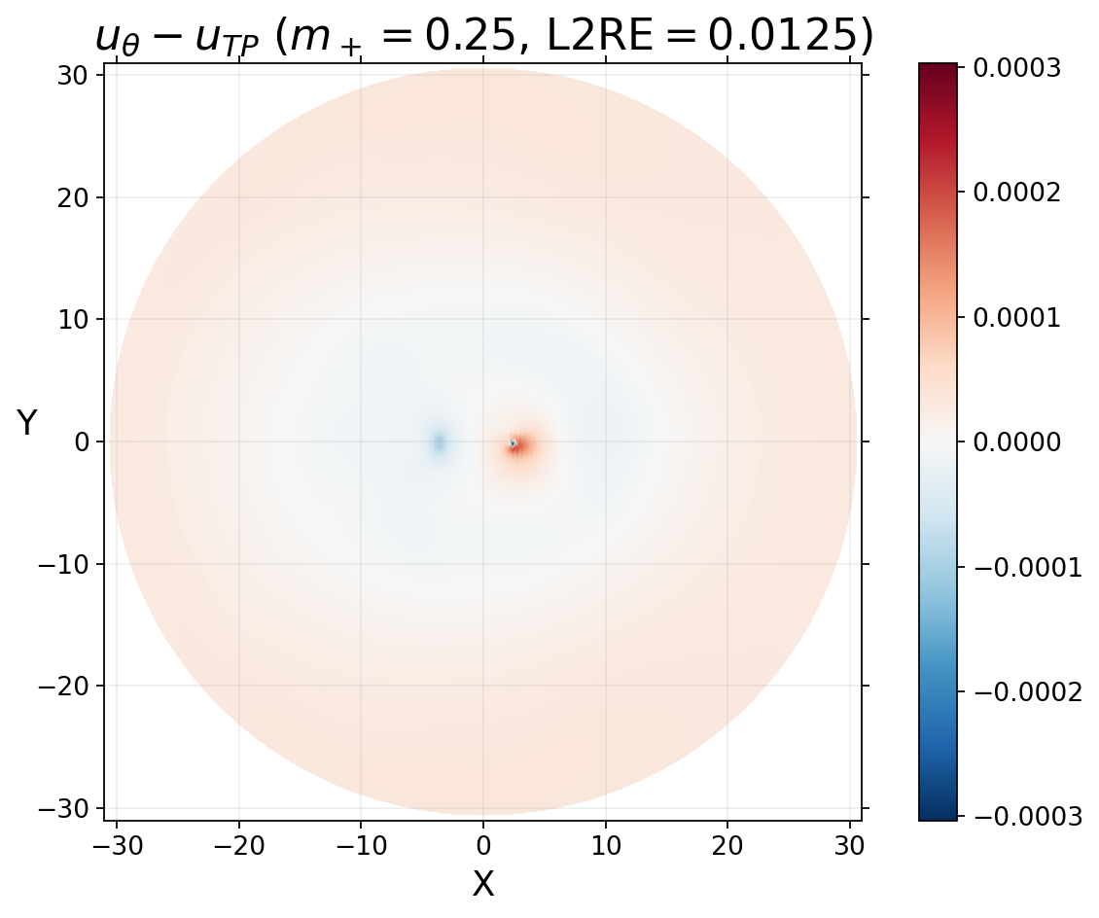
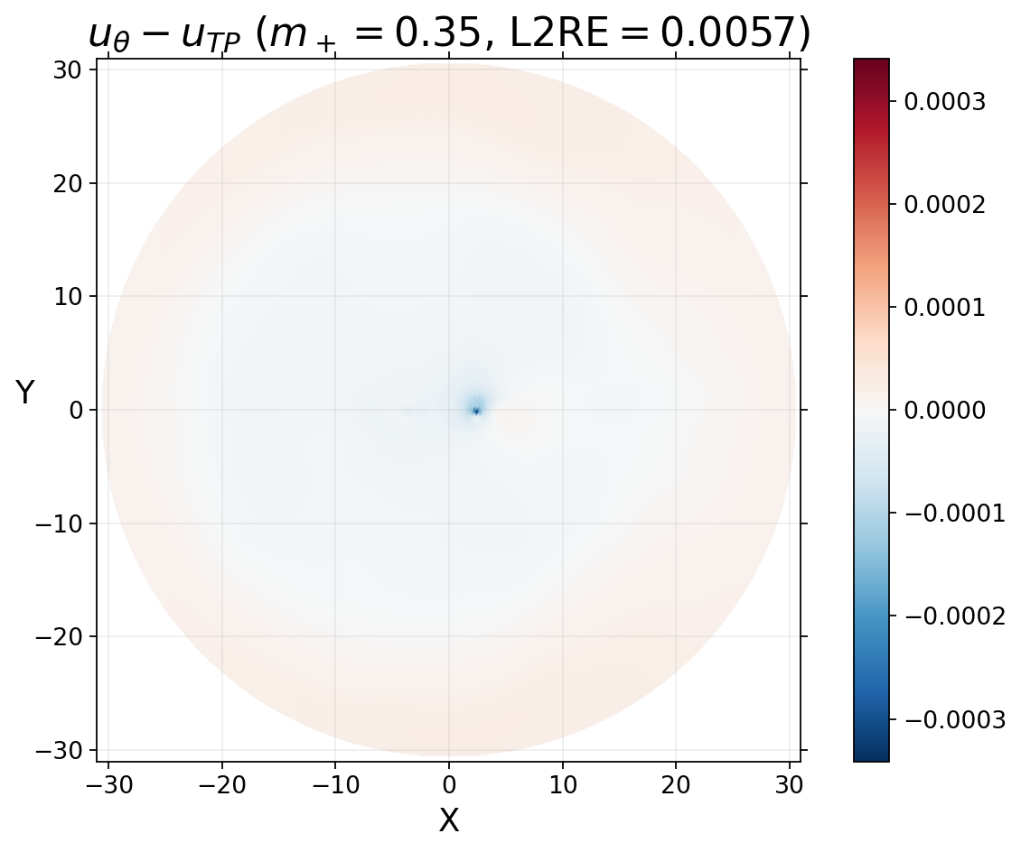
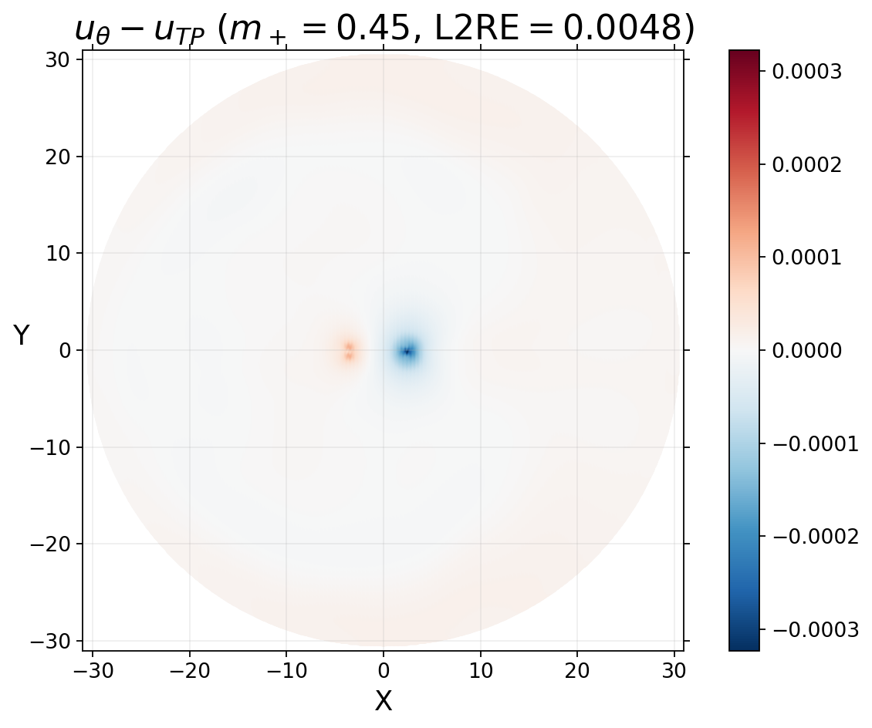
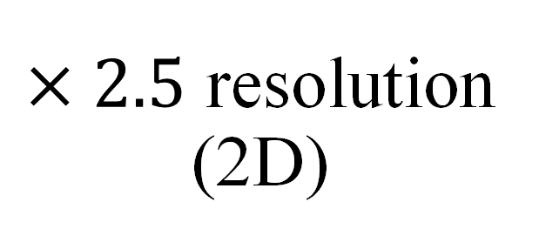
$×2.5$ resolution (2D)
Notes:
I generated a higher resolution 2D dataset for the 4 m-plus values, focusing on the xy-plane. As you can see on the screen, the deviations from the TwoPunctures data mostly occur in the immediate region surrounding the lower mass blackholes. Similar to the 3D case, higher m-plus values yield lower relative L2 errors, with a 3.5% error for m-plus 0.15 and 0.5% relative error for m-plus 0.45.

Slide 8
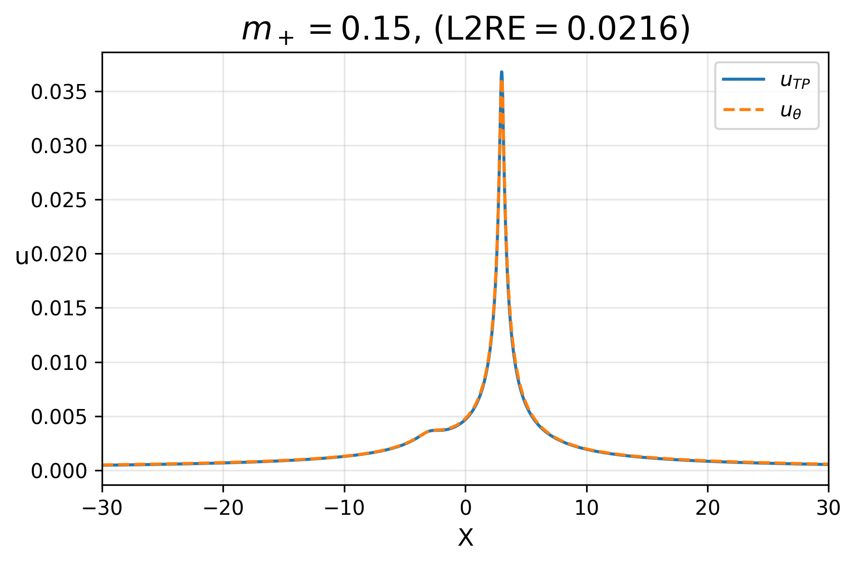
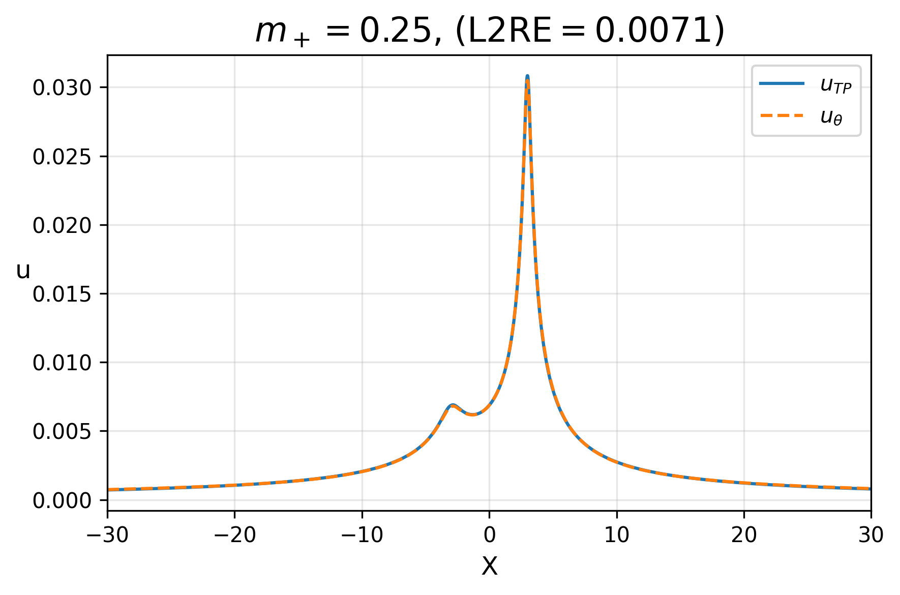
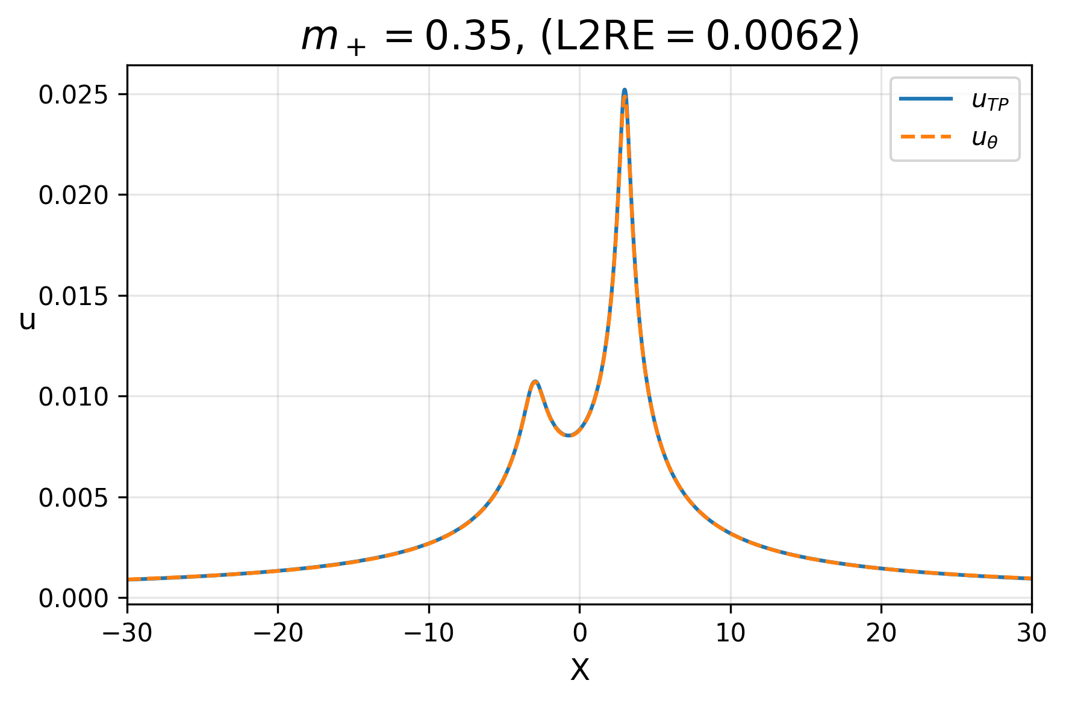
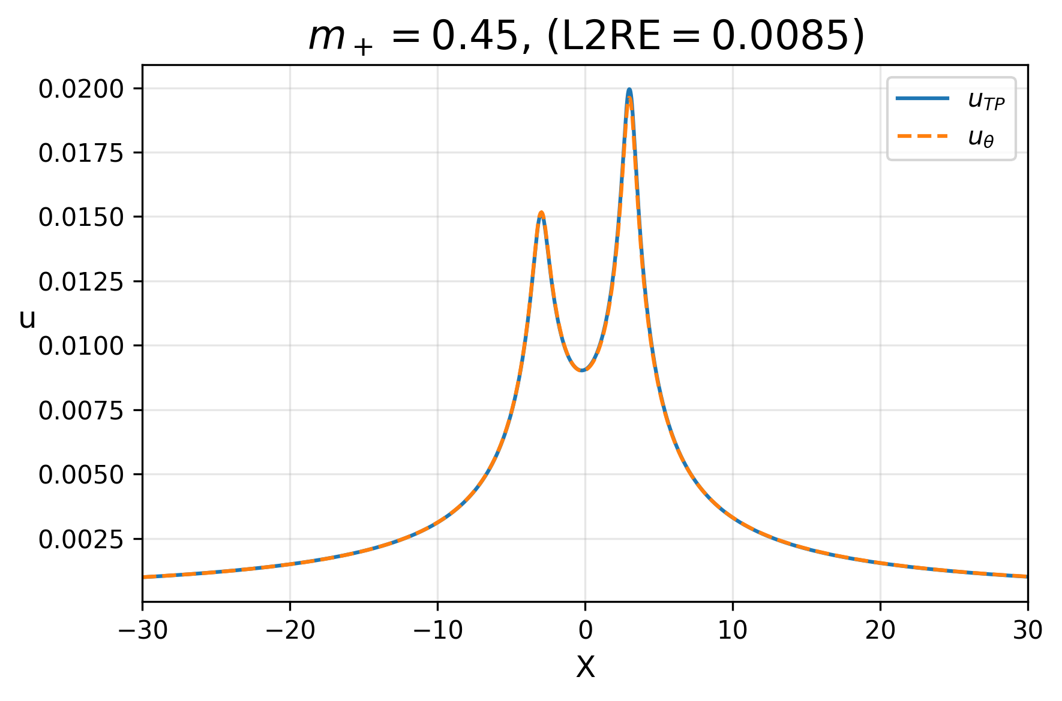
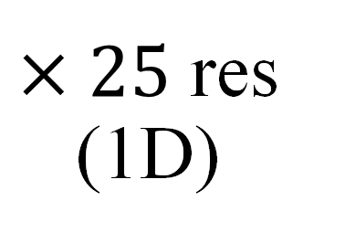
$×25$ res (1D)
Notes:
I also attempted to generate data on the x-axis while increasing the resolution to 25 times the training resolution. The generated data is in good agreement with the TwoPunctures data, resulting in less than 1% relative L2 errors for 3 out of the 4 testing m-plus values. However, all 4 cases show a systematic underprediction for the conformal factor correction term near the lower mass punctures, especially for m-plus 0.15, which has a relative L2 error of 0.0216.

Slide 9
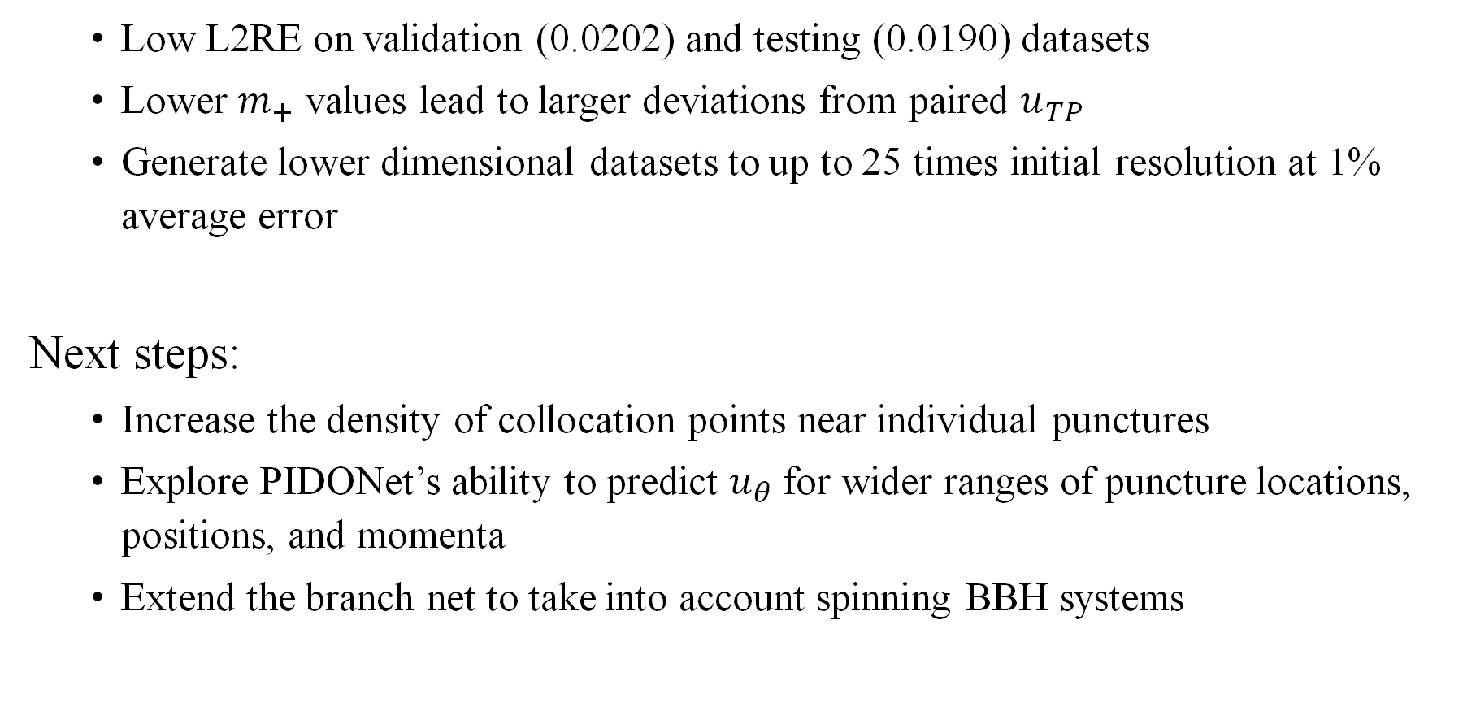
Conclusion
Low L2RE on validation (0.0202) and testing (0.0190) datasets
Lower $m_{+}$ values lead to larger deviations from paired $u_{TP}$
Generate lower dimensional datasets to up to 25 times initial resolution at 1% average error
Next steps:
Increase the density of collocation points near individual punctures
Explore PIDONet’s ability to predict $u_{θ}$ for wider ranges of puncture locations, positions, and momenta
Extend the branch net to take into account spinning BBH systems
Notes:
In conclusion, the low relative L2 errors on both the validation and testing datasets show proof of concept of using a Physics Informed DeepONet to generate binary black hole initial data.
In general, lower m-plus values lead to larger deviations from the paired TwoPunctures data, as the operator struggles to accurately predict sharp spatial changes in conformal factor correction due to lower mass blackholes.
However, the PIDONet can still generate lower-dimensional datasets to up to 25 times the initial resolution at 1% average relative L2 error.
For future iteration of this work , I suggest increasing the density of collocation points near the individual punctures, since that is where the largest difference between predicted and true values occur.
I would also explore the PIDONet’s ability to predict conformal factor correction term for wider ranges of puncture positions, masses and momenta, and to extend the branch net to also take the spins of the black holes as inputs.

Slide 10
Thank you for listening
Any questions?

